Slide 1
Long Term Hospitalizations Analysis Based on Potential Nosocomial Infections and Other Risk Factors
Hayoung Cheon
Solomon Mathews
Payden Bullis

Slide 2
Define variables
114 observations.
No missing data.
12 variables(9 numerical, 2 Categorical except ID)
 | Numerical Variables | Categorical Variables
1 | Length of Stay | Medical School Affiliation
2 | Age | Region
3 | Infection Risk
4 | Routine culturing ratio
5 | Routine chest X–ray ratio
6 | Number of beds
7 | Average Daily census
8 | Number of nurses
9 | Available facilities
Notes:
“We are defining the Routine Culturing Ratio and the Routine Chest Xray variables as the number of test per 100 patients, this could be either due to policy, best practice, or “as indicated” by patience risk factors and underlying conditions.” These metrics are commonly used to determine ‘nosocomial’ rates.
nosocomial is a disease originating in a hospital.

Slide 3
Define variables – 113 obs, 9 numeric, 2 categorical
Length of Stay
Hospital ID
Age
Average length of stay (in days)
Identification of a single hospital from the data
Average age of patients (years)
Infection Risk
Routine Culturing Ratio
Routine Chest X-ray Ratio
Average estimated probability of hospital infection
Ratio of # of cultures performed to number of patients without symptoms of infection times 100
Ratio of # of cultures performed to number of patients without symptoms of pneumonia time 100
Notes:
“We are defining the Routine Culturing Ratio and the Routine Chest Xray variables as the number of test per 100 patients, this could be either due to policy, best practice, or “as indicated” by patience risk factors and underlying conditions.” These metrics are commonly used to determine ‘nosocomial’ rates.
nosocomial is a disease originating in a hospital.

Slide 4
Define variables
Length of Stay
Hospital ID
Age
Average length of stay (in days)
Identification of a single hospital from the data
Average age of patients (years)
Infection Risk
Routine Culturing Ratio
Routine Chest X-ray Ratio
Average estimated probability of hospital infection
Ratio of # of cultures performed to number of patients without symptoms of infection times 100
Ratio of # of cultures performed to number of patients without symptoms of pneumonia time 100
Notes:
“We are defining the Routine Culturing Ratio and the Routine Chest Xray variables as the number of test per 100 patients, this could be either due to policy, best practice, or “as indicated” by patience risk factors and underlying conditions.” These metrics are commonly used to determine ‘nosocomial’ rates.
nosocomial is a disease originating in a hospital.

Slide 5
Define variables
Number of Beds
Medical School Affiliation
Average Daily Census
Average number of beds in the hospital
Whether or not the hospital is associated with a medical school
Average number of patients in hospital per day
Number of Nurses
Region
Available Facilities
Average number of full-time nurses
Geographic region
Northeast, North Central, South, West
Percent of 35 potential facilities and services that are provided by the hospital
Notes:
Cover these topics quickly, no need to read off the exact text from the boxes.
Geography, region isn’t defined but probably clear with regard to typical understanding of how the US is generally divided.
List of potential Facilities you can read off a few of these not the entire list.
Emergency Care 2. Surgery 3. Maternity Care 4. Pediatrics 5. Cardiology 6. Oncology 7. Neurology 8. Orthopedics 9. Gastroenterology 10. Dermatology 11. Psychiatry 12. Radiology 13. Pathology 14. Anesthesiology 15. Intensive Care Unit (ICU) 16. Rehabilitation Services 17. Physical Therapy 18. Occupational Therapy 19. Speech Therapy 20. Pharmacy 21. Laboratory Services 22. Outpatient Department (OPD) 23. Ward Facilities 24. Nursing Services 25. Medical Imaging (MRI, CT scans) 26. Dialysis 27. Palliative Care 28. Urgent Care 29. Endoscopy 30. Vascular Surgery 31. Plastic Surgery 32. Gynecology 33. Pulmonology 34. ENT (Ear, Nose, and Throat) 35. Specialty Clinics (e.g., diabetes, hypertension)

Slide 7
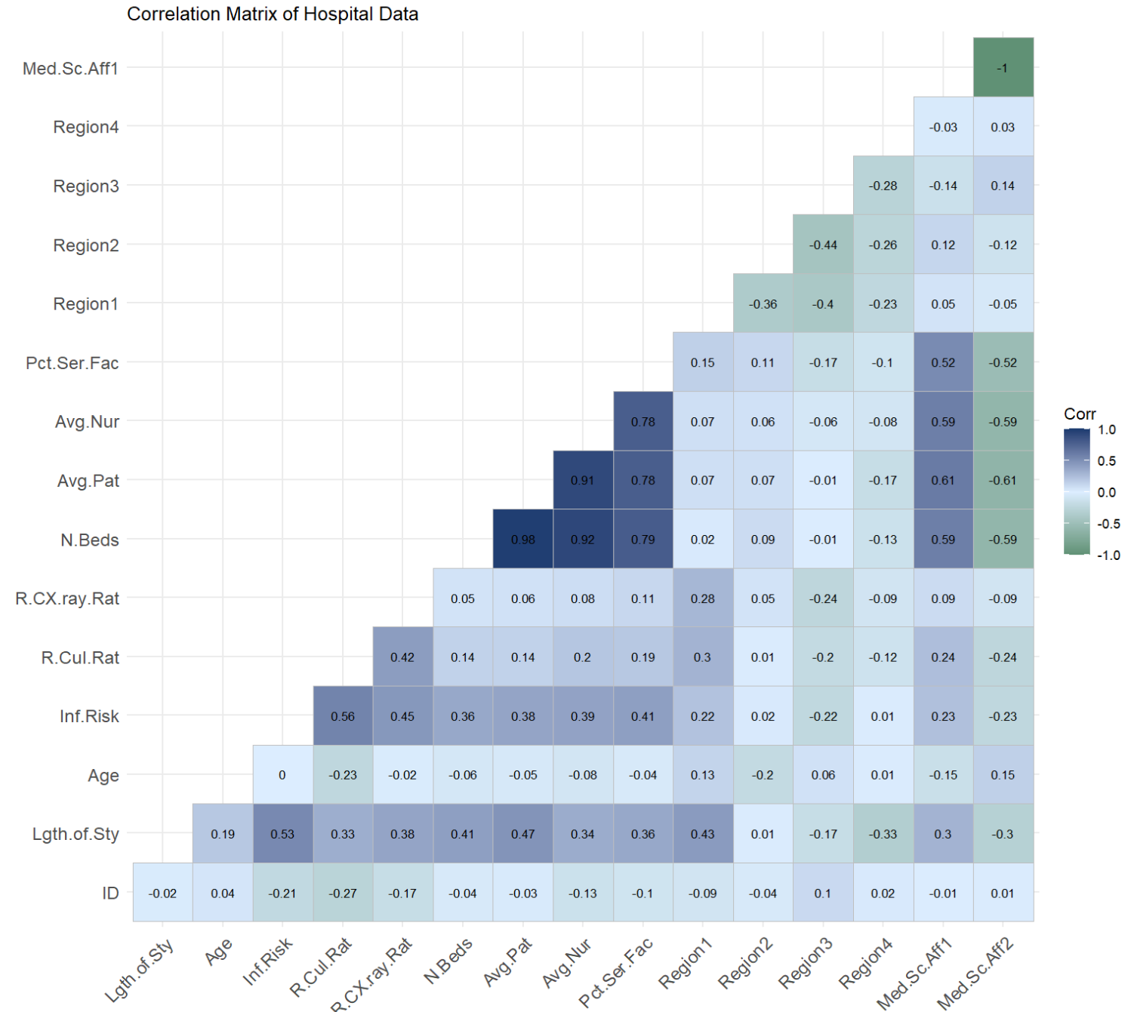
EDA and Summary Information

Slide 8
EDA and Summary Information
Number of Beds
Coefficient: -0.004851 T stat: 1.864 P_{value} : 0.065222
Routine Chest X-ray Ratio
Coefficient: 0.012688 T stat: 1.775 P_{value} : 0.078892
Medical School Affiliation
Coefficient: -0.266644 T stat: -0.605 P_{value} : 0.546872
Infection Risk
Coefficient: 0.439665 T stat: 3.454 P_{value} : 0.000812
Routine Culturing Ratio
Coefficient: 0.005546 T stat: 0.347 P_{value} : 0.729299
Age
Coefficient: 0.079922 T stat: 2.827 P_{value} : 0.005668
Average Daily Census
Coefficient: 0.015182 T stat: 3.432 P_{value} : 0.000872
Number of Nurses
Coefficient: -0.005891 T stat: -2.656 P_{value} : 0.009203
Region
Coefficient: XXXXX T stat: XXXXX P_{value} : XXXXX
Services Provided
Coefficient: -0.012179 T stat: -0.884 P_{value} : 0.378698

Slide 9
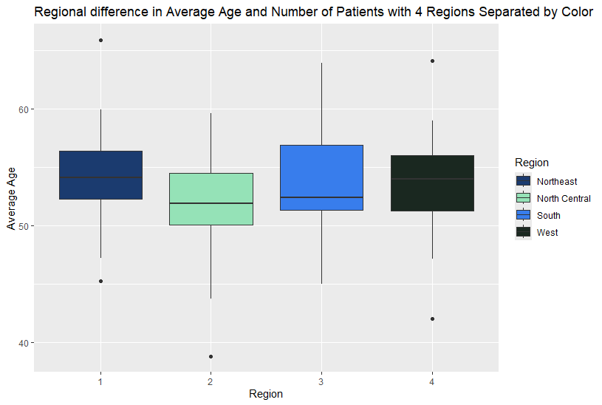
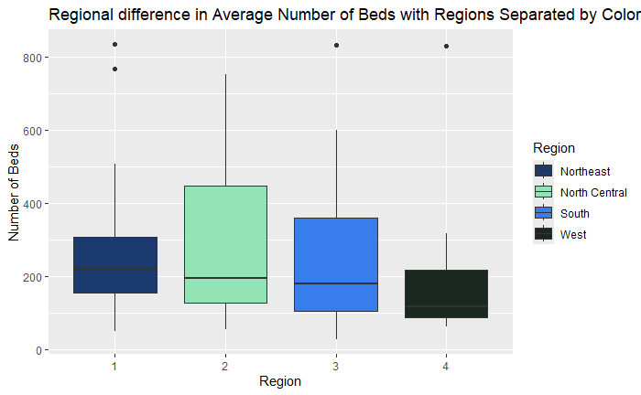
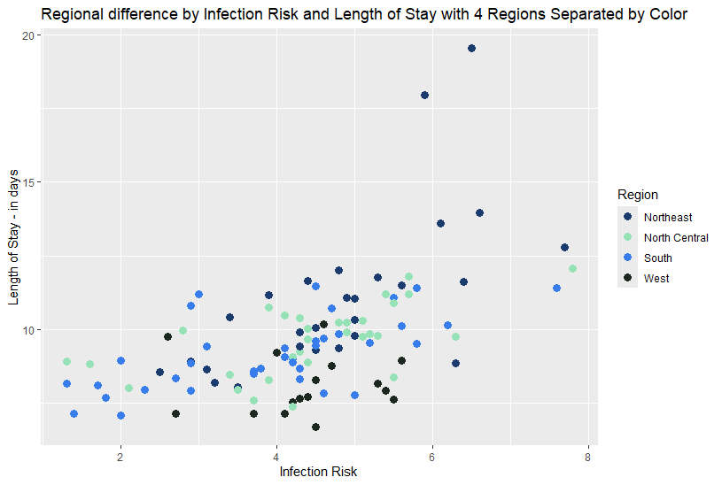
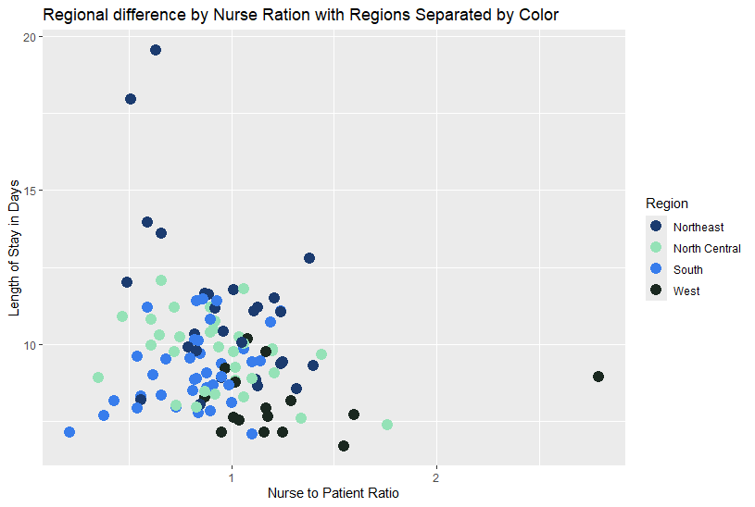

Slide 10
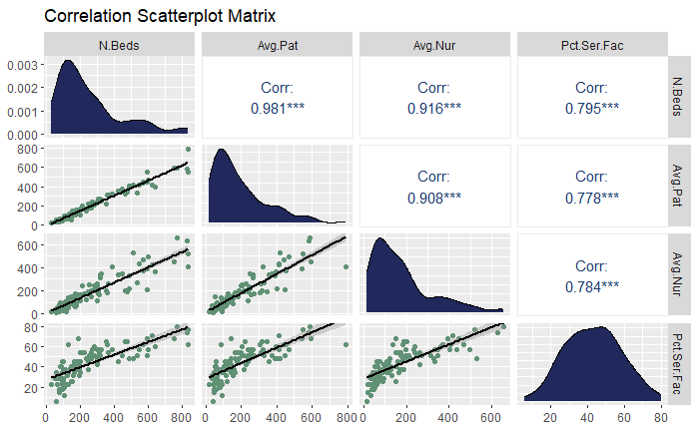
Correlation Matrix with potential Multicollinearity
Notes:
Reviewing the scatter plots for the variables it appears that there are several variables that display some degree of multicollinearity and will need to be addressed during model building.

Slide 11
Objective One
What factors could potentially extend a patient’s stay?
Notes:
For the first objective this model seeks to determine if the infection risk, routine culture rate and routine chest xray are associated with a patients length of stay in a hospital

Slide 12
Objective 1 Summary Table
Infection Risk
Coefficient: XXXXX T stat: XXXXX P_{value} : XXXXX
Routine Chest X-ray Ratio
Coefficient: XXXXX T stat: XXXXX P_{value} : XXXXX
Routine Culturing Ratio
Coefficient: XXXXX T stat: XXXXX P_{value} : XXXXX
Number of Beds
Coefficient: XXXXX T stat: XXXXX P_{value} : XXXXX
Medical School Affiliation
Coefficient: XXXXX T stat: XXXXX P_{value} : XXXXX
Age
Coefficient: XXXXX T stat: XXXXX P_{value} : XXXXX
Average Daily Census
Coefficient: XXXXX T stat: XXXXX P_{value} : XXXXX
Number of Nurses
Coefficient: XXXXX T stat: XXXXX P_{value} : XXXXX
Region
Coefficient: XXXXX T stat: XXXXX P_{value} : XXXXX
Services Provided
Coefficient: XXXXX T stat: XXXXX P_{value} : XXXXX

Slide 13
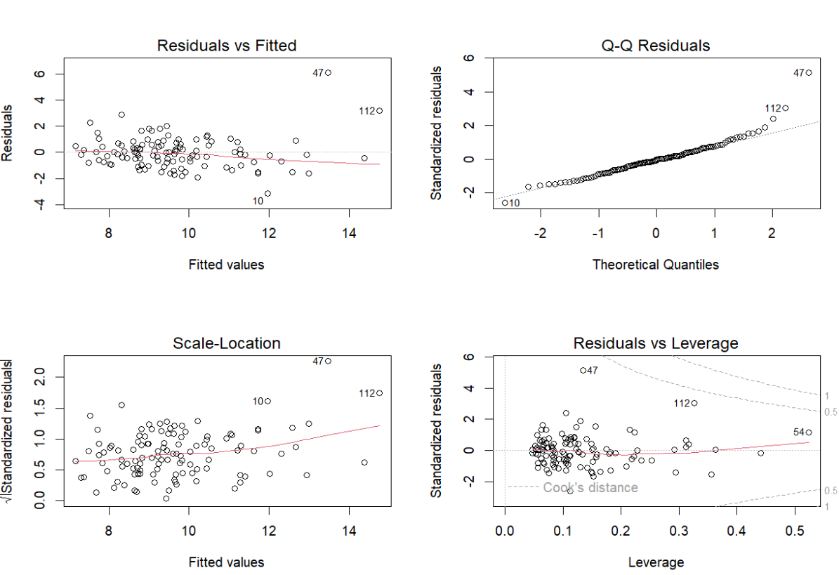
Definition of Object one
Assumptions and potential issues with the data.
Normalization:
Q-Q plot -> normally distributed.
Cook’s distance -> outliers remain within the threshold, no leverage
Constant Variance:
Residuals vs. fitted: evenly dispersed around the read reference line at zero. No funnel shape.
Independence: ??

Slide 14
Objective One - conclusion
Infection risk: For every unit increase in infection risk, there is an increase of 0.4397 in the length of stay holding the other variables fixed.(p-value < 0.05 )
Routine culturing Ratio: For every unit increase in Routine culturing Ratio, there is an increase of 0.005546 in the length of stay holding the other variables fixed. (p-value > 0.05)
Routine chest X-ray ratio: For every unit increase in Routine chest X-ray ratio, there is an increase of 0.079922 in the length of stay holding the other variables fixed. (p-value > 0.05)

Slide 15
Objective 2
Outline of the problem and predictions here

Slide 16
Objective 2 – complexity
In the data analysis phase we discovered that (variable) demonstrated a potential polynomial relationship and adjusted them as such

Slide 17
Model Building
Number of Beds
VIF:
(summary of variable and it’s use in the model Y/N)
Routine Chest X-ray Ratio
VIF:
(summary of variable and it’s use in the model Y/N)
Medical School Affiliation
VIF:
(summary of variable and it’s use in the model Y/N)
Infection Risk
VIF:
(summary of variable and it’s use in the model Y/N)
Routine Culturing Ratio
VIF:
(summary of variable and it’s use in the model Y/N)
Age
VIF:
(summary of variable and it’s use in the model Y/N)
Average Daily Census
VIF:
(summary of variable and it’s use in the model Y/N)
Number of Nurses
VIF:
(summary of variable and it’s use in the model Y/N)
Region
VIF:
(summary of variable and it’s use in the model Y/N)
Services Provided
VIF:
(summary of variable and it’s use in the model Y/N)

Slide 18
Objective 2
Assumptions and potential issues with the data. RMSE and other accuracy metric would go here along with Relevant residuals to demonstrate assumptions

Slide 19
Objective 2 - KNN
KNN model and details such as k term and other considerations. Summary of how the knn was built

Slide 20
Objective Two - conclusions

Slide 21
Conclusion

Slide 22
Instructions for use
If you have a free account, in order to use this template, you must credit Slidesgo by keeping the Thanks slide. Please refer to the next slide to read the instructions for premium users.
As a Free user, you are allowed to:
Modify this template.
Use it for both personal and commercial projects.
You are not allowed to:
Sublicense, sell or rent any of Slidesgo Content (or a modified version of Slidesgo Content).
Distribute Slidesgo Content unless it has been expressly authorized by Slidesgo.
Include Slidesgo Content in an online or offline database or file.
Offer Slidesgo templates (or modified versions of Slidesgo templates) for download.
Acquire the copyright of Slidesgo Content.
For more information about editing slides, please read our FAQs or visit Slidesgo School:
https://slidesgo.com/faqs and https://slidesgo.com/slidesgo-school

Slide 23
Instructions for use (premium users)
As a Premium user, you can use this template without attributing Slidesgo or keeping the "Thanks" slide.
You are allowed to:
Modify this template.
Use it for both personal and commercial purposes.
Hide or delete the “Thanks” slide and the mention to Slidesgo in the credits.
Share this template in an editable format with people who are not part of your team.
You are not allowed to:
Sublicense, sell or rent this Slidesgo Template (or a modified version of this Slidesgo Template).
Distribute this Slidesgo Template (or a modified version of this Slidesgo Template) or include it in a database or in any other product or service that offers downloadable images, icons or presentations that may be subject to distribution or resale.
Use any of the elements that are part of this Slidesgo Template in an isolated and separated way from this Template.
Register any of the elements that are part of this template as a trademark or logo, or register it as a work in an intellectual property registry or similar.
For more information about editing slides, please read our FAQs or visit Slidesgo School:
https://slidesgo.com/faqs and https://slidesgo.com/slidesgo-school

Slide 24
Use our editable graphic resources...
You can easily resize these resources without losing quality. To change the color, just ungroup the resource and click on the object you want to change. Then, click on the paint bucket and select the color you want. Group the resource again when you’re done. You can also look for more infographics on Slidesgo.

Slide 27
JANUARY
FEBRUARY
MARCH
APRIL
MAY
JUNE
PHASE 1
Task 1
Task 2
PHASE 2
Task 1
Task 2
JANUARY
FEBRUARY
MARCH
APRIL
PHASE 1
Task 1
Task 2

Slide 30
...and our sets of editable icons
You can resize these icons without losing quality.
You can change the stroke and fill color; just select the icon and click on the paint bucket/pen.
In Google Slides, you can also use Flaticon’s extension, allowing you to customize and add even more icons.

Slide 31
Educational Icons
Medical Icons

Slide 32
Business Icons
Teamwork Icons

Slide 33
Help & Support Icons
Avatar Icons

Slide 34
Creative Process Icons
Performing Arts Icons

Slide 35
Nature Icons

Slide 36
SEO & Marketing Icons

Slide 37


